Slide 1
RESTAURANT
MANAGEMENT
SYSTEM
(using python Tkinter and sqlite3)

Slide 2
Introduction
Features of the Restaurant Management System
User Interface Design
Database Management
Benefits of Using Restaurant Management System
Conclusion

Slide 3
Introduction
As the food industry continues to grow, it's becoming increasingly important for restaurants to have an efficient and effective way of managing their operations.
Our restaurant management system is designed to streamline processes, reduce errors, and improve customer satisfaction. By using CustomTkinter and SQLite3 in Python, we've created a powerful tool that can benefit restaurant owners and staff alike.

Slide 4
Features of the Restaurant Management System
Adding menu among offered menus.
Getting the receipt in form of a text file by the name of the cstomer enterd.
Choice of getting the receipt on whatsapp number entered.

Slide 5
USER INTERFACE DESIGN

Slide 6
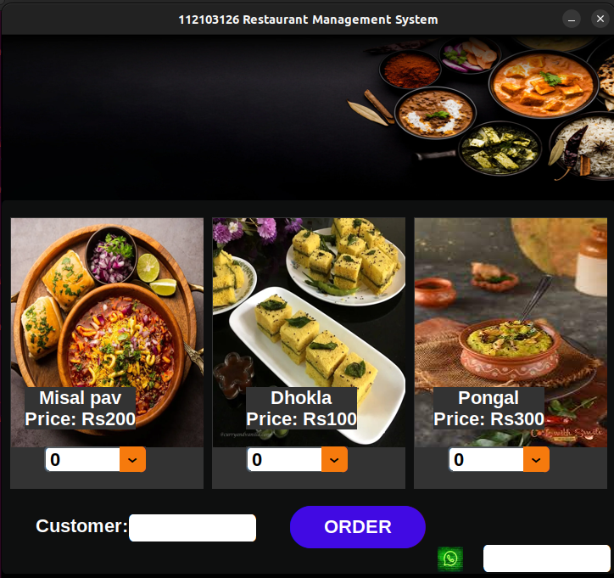
(a) ORDER button
Gets the total price displays it on the screen and creates a receipt in form of a text file.
(b) Send button
Automatically sends the receipt on whatsapp number entered in form of a whatsapp message.

Slide 7
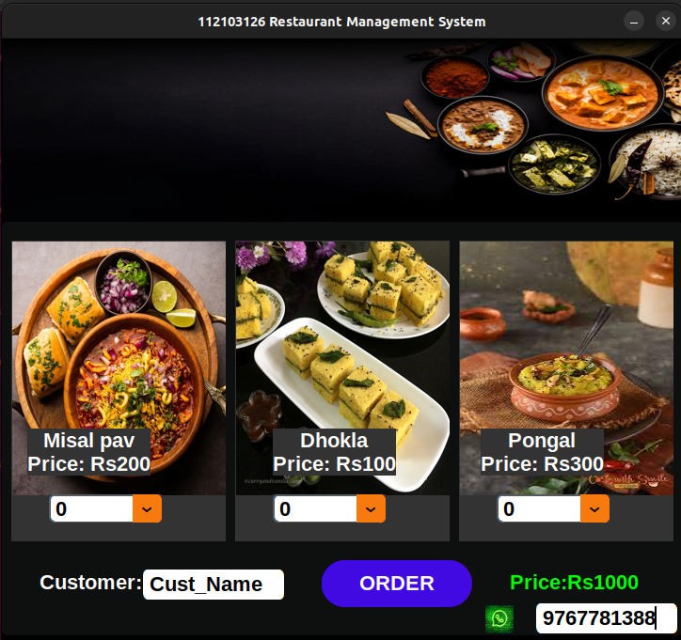
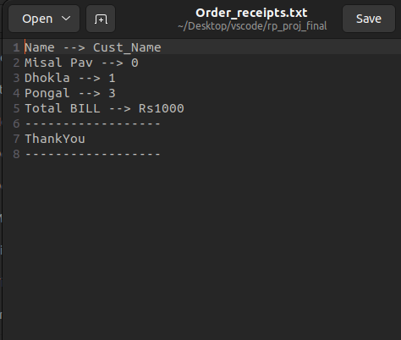

Slide 8
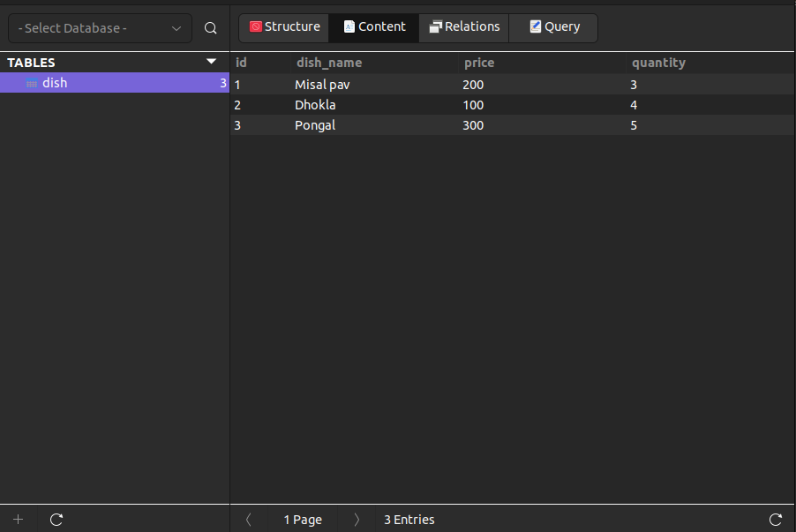
Database

Slide 9
Benefits of Using Restaurant Management System
Using a restaurant management system can greatly improve the efficiency of your restaurant operations. The system allows for easy tracking of orders and inventory, reducing errors and saving time. With real-time data on hand, managers can make informed decisions and streamline their processes.
In addition to improving efficiency, the restaurant management system can also enhance customer satisfaction. By streamlining the ordering process, customers can receive their food faster and with fewer mistakes. The system can also store customer information, allowing for personalized service and targeted marketing efforts. Overall, implementing a restaurant management system can lead to happier customers and increased revenue.

Slide 10
Conclusion
In conclusion, we have discussed the various features of the restaurant management system, including its user interface design and database management capabilities. We have also highlighted the benefits of using the system, such as improving efficiency, reducing errors, and increasing customer satisfaction.
Implementing a restaurant management system can be a game-changer for your business. By streamlining operations and providing valuable data insights, the system can help you make informed decisions that can improve your bottom line. Don't wait any longer to take advantage of this powerful tool.

Slide 11
THANKYOU!

